Slide 1
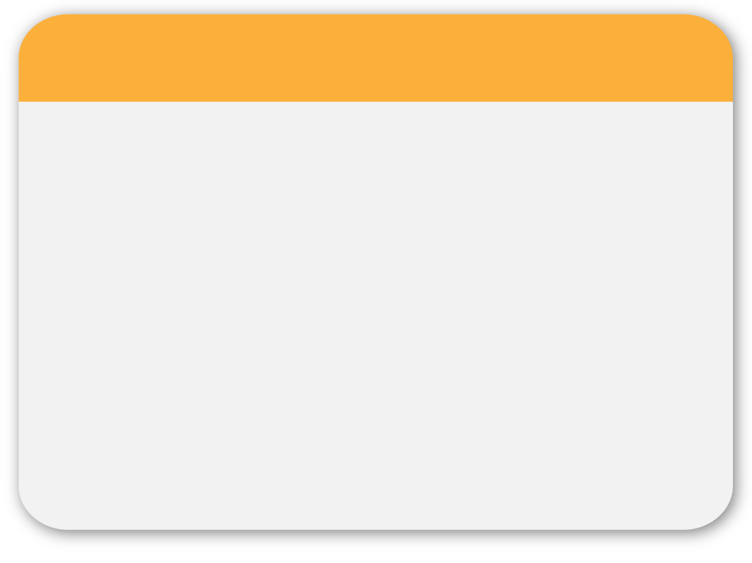
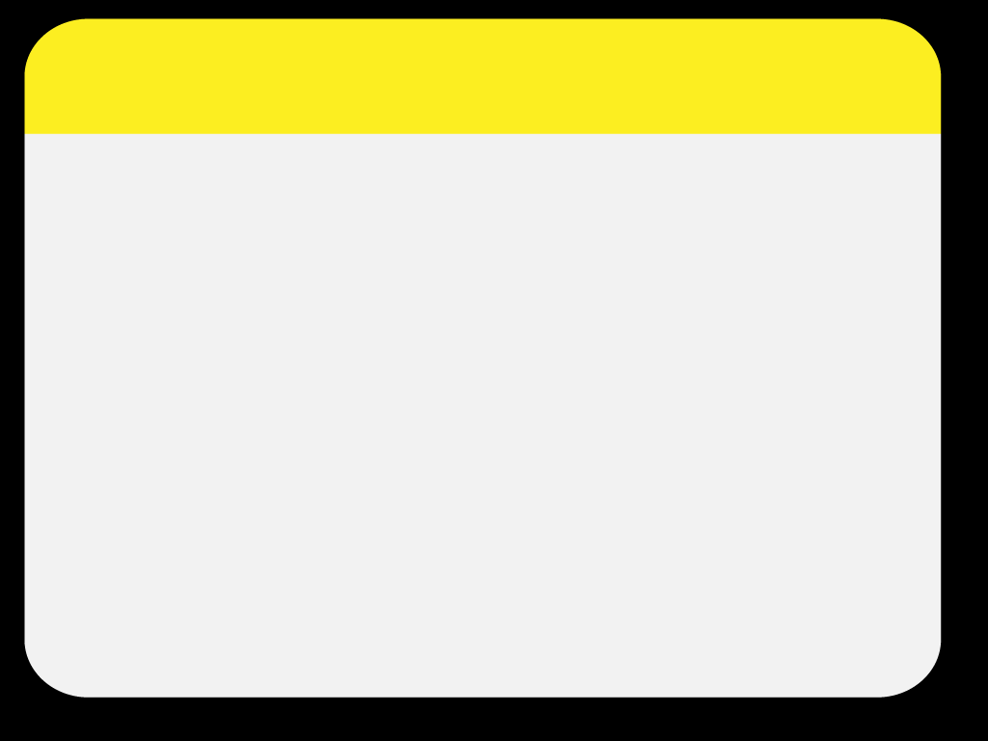
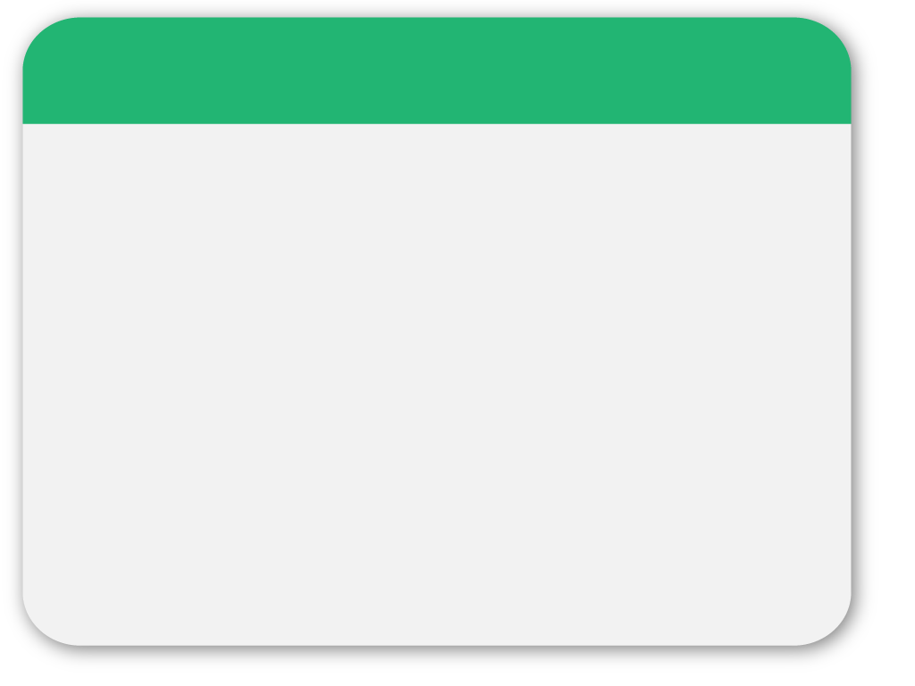
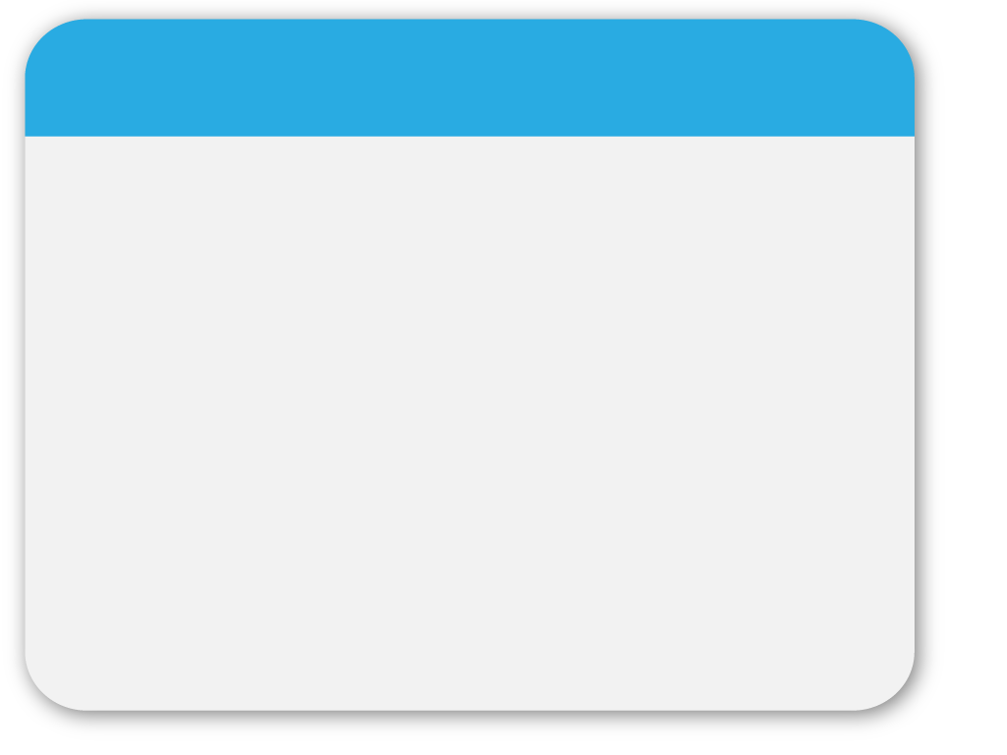
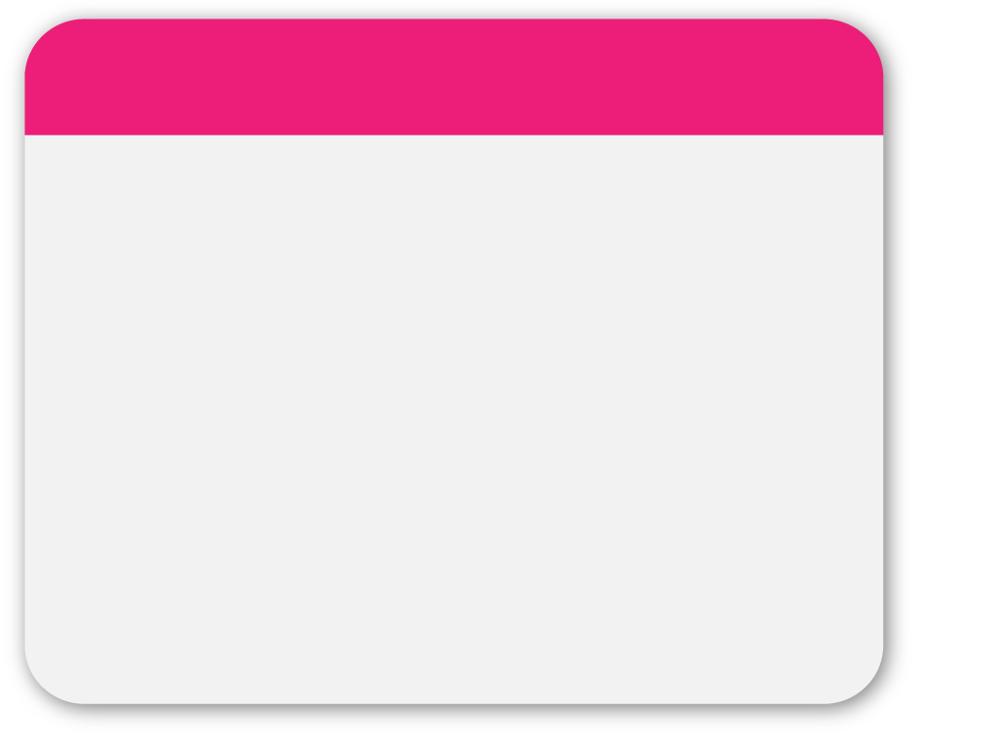
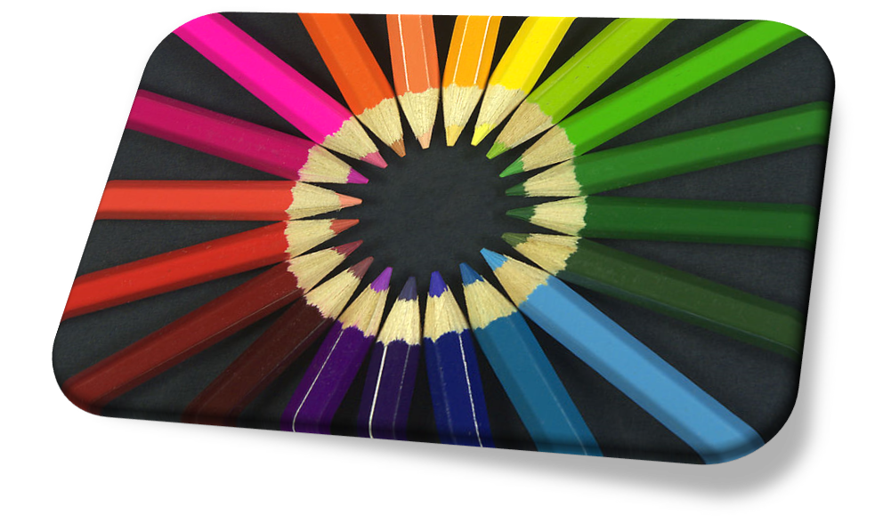
03
WINTER
“COLOR“
Template
Multimedia Dasar

Slide 2
WINTER
Template
Multimedia Dasar

Slide 3
What is Color 02
Color is the visual perceptual property corresponding in humans to the categories called red, blue, yellow, green and others

Slide 4
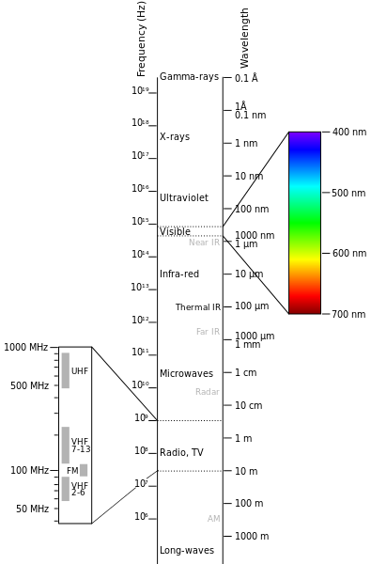
What is Color
Color or colour derives from the spectrum of light interacting in the eye with the spectral sensitivities of the light receptors.

Slide 5
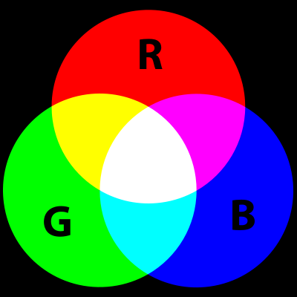
RGB 03

Slide 6
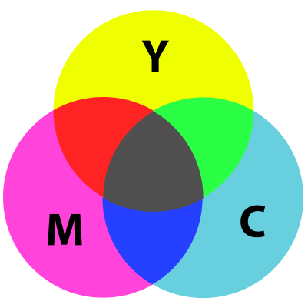
CMYK 04

Slide 7
Why study color? 05
can change the mood of the image, or impact the story
can also draw the viewers eyes to a focal element

Slide 8
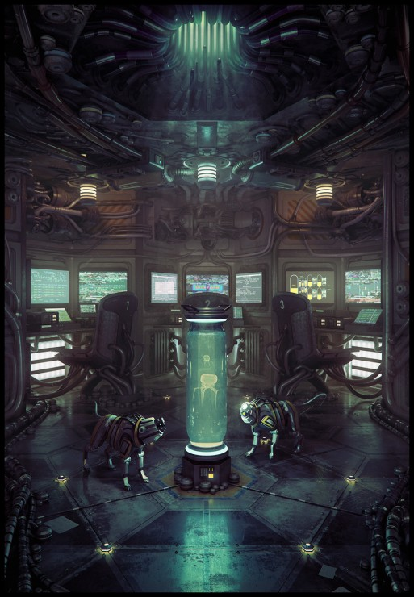
06
Where is the focus of this image?

Slide 9
05
You are free to use these templates for your personal and business presentations.

